Slide 1
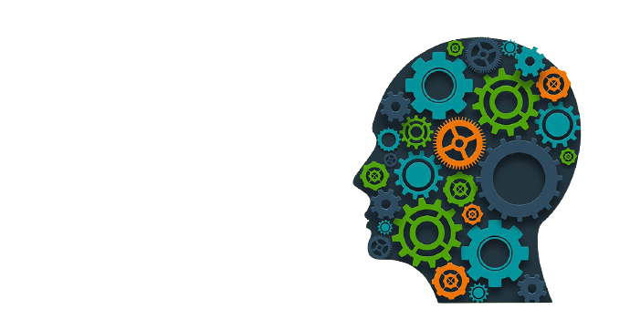

MACHINE LEARNING
USING PYTHON
INNOCENT CHARLES
MLOps Engineer
The greatest secret is attitude and passion.

Slide 2
CONTENTS TO BE COVERED
Introduction
Machine Learning
Types of Machine Learning
ML workflows
ML tools Mostly Used in ML
Application of AI
Supervised Machine Learning
Regression
Finding the Best Fit Line
Hands on Data (practical implementation)

Slide 3
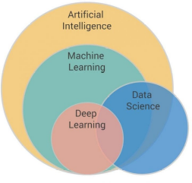
INTRODUCTION
What is the difference between ML , AI , DL , DE and DS ?
Raise your hand if you’ve been caught in the confusion of differentiating artificial intelligence (AI) vs machine learning (ML) vs deep learning (DL) vs Data Science(DS) vs Data Engineering (DE)…
Bring down your hand, buddy, we can’t see it!
Data Engineering

Slide 4
INTRODUCTION
Artificial Intelligence:
Concerned with building smart machines and intelligent system capable of performing tasks that typically require human intelligence.
Machine Learning:
- Is a branch of AI based on the idea that systems can learn from data, identify patterns and make decisions with minimal human intervention.
Deep Learning:
- Is a subset of ML that use a cascade of multiple layers of non-linear processing and artificial neural networks to deliver high accuracy for pattern recognition and feature learning , it stimulates the neurons of the human brain .
Data Science:
- Is the science of extracting useful knowledge and insights from data and apply that knowledge and actionable insights on different application domain.
Data Engineering:
-the practice designing and building systems for collecting, storing, and analyzing data at scale and make those raw data to be used by data scientists or organization

Slide 5
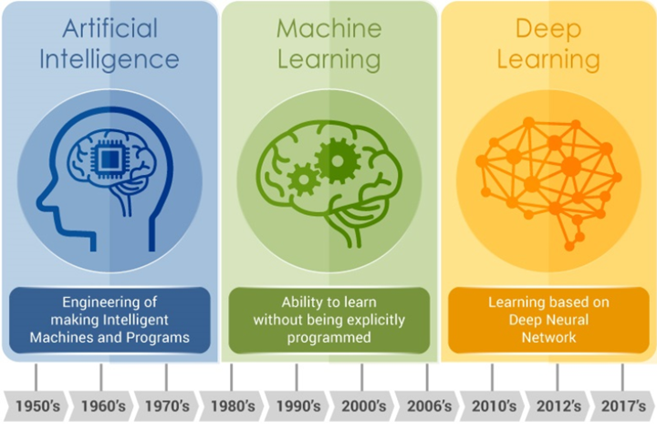
INTRODUCTION
To make it more simple is :
Data engineering produces raw data
Data science produces insights
Machine learning produces predictions
Artificial intelligence produces Actions

Slide 6
CASE STUDY ON AI ,ML AND DS
Suppose we were building a self-driving car, and were working on the specific problem of stopping at stop signs. We would need skills drawn from all three of these fields.
Machine learning: The car has to recognize a stop sign using its cameras. We construct a dataset of millions of photos of streetside objects, and train an algorithm to predict which have stop signs in them.
Artificial intelligence: Once our car can recognize stop signs, it needs to decide when to take the action of applying the brakes. It’s dangerous to apply them too early or too late, and we need it to handle varying road conditions (for example, to recognize on a slippery road that it’s not slowing down quickly enough), which is a problem of control theory.
Data science: In street tests we find that the car’s performance isn’t good enough, with some false negatives in which it drives right by a stop sign. After analyzing the street test data, we gain the insight that the rate of false negatives depends on the time of day: it’s more likely to miss a stop sign before sunrise or after sunset. We realize that most of our training data included only objects in full daylight, so we construct a better dataset including nighttime images and go back to the machine learning step.

Slide 7
MACHINE LEARNING BY USING SCIKIT-LEARN AND PYTHON

Slide 8
MACHINE LEARNING
What exactly Machine Machine Learning is ?
What does it mean to learn?
In Machine Learning an important concept is Generalization, the ability to generalize.

Slide 9
MACHINE LEARNING
What exactly Machine Machine Learning is ?
A computer program is said to learn from experience E with respect to some task T and some performance P, if its performance on T, as measured by P, improves with experience E.
- Tom Mitchell, 1997.

Slide 10
MACHINE LEARNING
Generally , Machine Learning can be defined as a subset of artificial intelligence that is mainly concerned with the development of algorithms which allow a computer to learn from the data and past experiences on their own to identify the pattern and making prediction without being programmed explicit.
Example :
”You need to predict how much user “A” will like a movie that she hasn’t seen based on her ratings of movies that she has seen.”
Basically;There are two ways to solve these kind of problem;
Traditional Programming Methods
Machine Learning Methods .

Slide 11
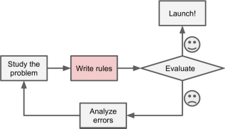
MACHINE LEARNING
A.Traditional Programming Methods:
-Complex
-Hard to Maintain

Slide 12
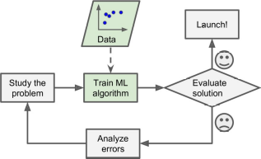
MACHINE LEARNING
A.Machine Learning Methods:
-Automatic pattern learning - Ease to maintain -Adoption to changes
-More accurate

Slide 13
TYPES OF THE MACHINE LEARNING
Generally : There are about Four type of the Machine Learning
Supervised Learning
Unsupervised Learning
Semi-supervised Learning
Reinforcement Learning

Slide 14
SUPERVISED LEARNING
Training data includes the desired solutions called labels.
SOME SUPERVISED LEARNING ALGORITHMS :
-Linear and logistic regression
-Support Vector Machines
-Decision trees
-Random forest
-Naive Bayes
-K-nearest Neighbours
-Neural Networks

Slide 15
UNSUPERVISED LEARNING
Training data DOES NOT includes the desired solutions called labels. Hence a machine has to find some structure in the dataset.They only extracts pattern from the provided data during learning.
SOME UNSUPERVISED LEARNING ALGORITHMS :
-k-means and hierarchical algorithms
-Principal component Analysis and factor analysis , independent component Analysis , linear discriminant analysis
-Apriori Algorithm
-Neural Networks

Slide 16
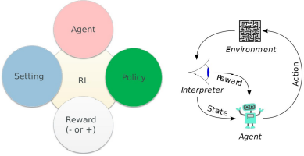
REINFORCEMENT LEARNING
Machine learning type that an agent is able to perceive and interpret its environment ,take actions ,learn through trial and error to make the right decision. Example games , Autonomous self driving car . The agent continues doing these three things (take action,change state/remain in the same state,get feedback)

Slide 17
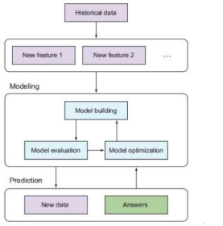
ML WORKFLOW

Slide 18
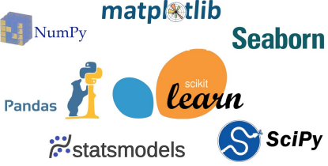

ML TOOLS MOSTLY USED IN ML

Slide 19
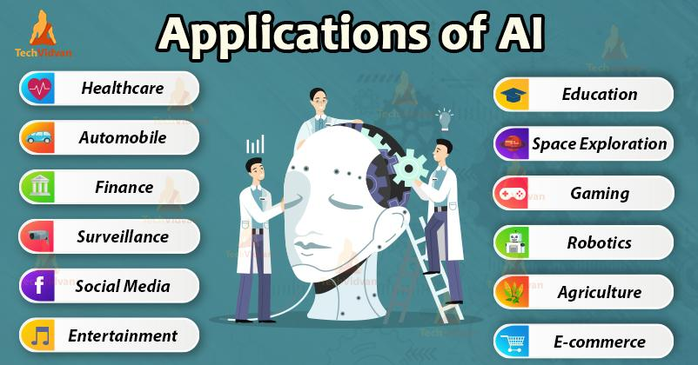
APPLICATION OF ARTIFICIAL INTELLIGENCE

Slide 20


Slide 21
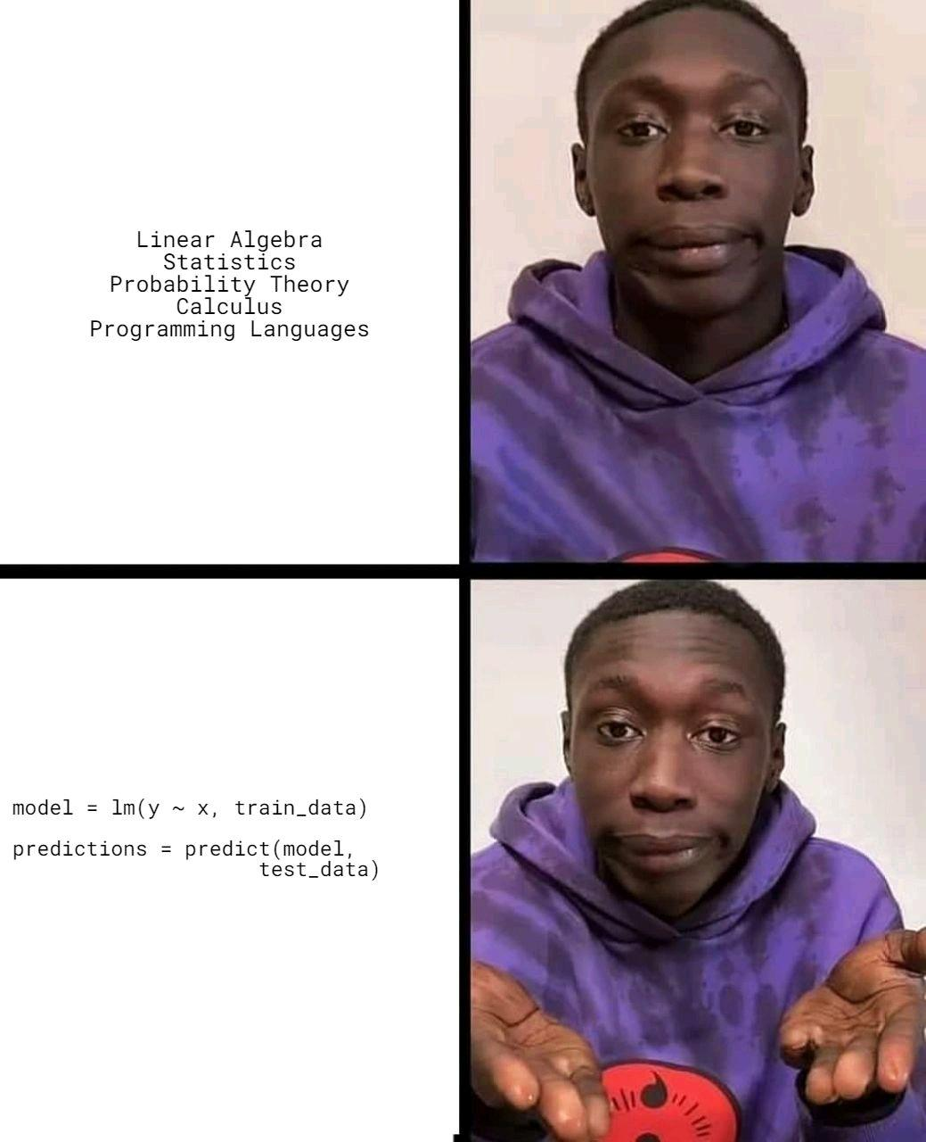

Slide 22
ROADMAP FOR AI
A COMPLETE ROADMAP FOR AI Expert 2021-2022

Slide 23
SUPERVISED MACHINE LEARNING

Slide 24
SUPERVISED MACHINE LEARNING
is a subcategory of machine learning and artificial intelligence. It is defined by its use of labeled datasets to train algorithms that to classify data or predict outcomes accurately. As input data is fed into the model, it adjusts its weights until the model has been fitted appropriately, which occurs as part of the cross validation process.
In supervised learning, the training data provided to the machines work as the supervisor that teaches the machines to predict the output correctly. It applies the same concept as a student learns in the supervision of the teacher.
Supervised learning is a process of providing input data as well as correct output data to the machine learning model. The aim of a supervised learning algorithm is to find a mapping function to map the input variable(x) with the output variable(y).
Supervised learning helps organizations solve for a variety of real-world problems at scale such as Risk Assessment, Image classification, Fraud Detection, spam filtering, etc.

Slide 25
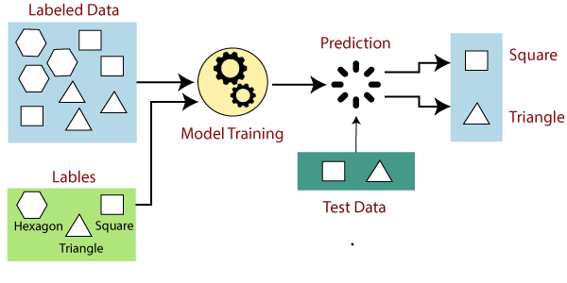
HOW SUPERVISED LEARNING WORK ?
Supervised learning uses a training set to teach models to yield the desired output. This training dataset includes inputs and correct outputs, which allow the model to learn over time. The algorithm measures its accuracy through the loss function, adjusting until the error has been sufficiently minimized.

Slide 26
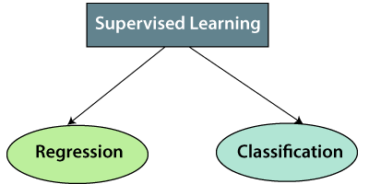
TYPE OF THE SUPERVISED LEARNING
Basically ; Supervised Machine Learning is classified into Two groups:

Slide 27
TYPE OF THE SUPERVISED LEARNING
Classification uses an algorithm to accurately assign test data into specific categories. It recognizes specific entities within the dataset and attempts to draw some conclusions on how those entities should be labeled or defined.It based on the discrete datasets.Example to classify yes or No , fraud or not Fraud . Common classification algorithms are linear classifiers Example logistic classifiers, support vector machines (SVM), decision trees, k-nearest neighbor, and random forest, naive bayes .
Regression is used to understand the relationship between dependent and independent variables. It is commonly used to make projections and the prediction of continuous variables, such as Weather forecasting, Market Trends, sales revenue for a given business. Popular algorithms under this are linear regression,random forest,support vector regression,decision trees,neural networks,lasso and ridge regression

Slide 28
REGRESSION
Regression analysis is a statistical method to model the relationship between a dependent (target) and independent (predictor) variables with one or more independent variables. More specifically, Regression analysis helps us to understand how the value of the dependent variable is changing corresponding to an independent variable when other independent variables are held fixed. It predicts continuous/real values such as temperature, age, salary, price, etc.We can understand the concept of regression analysis using the below example:
Example: Suppose there is a marketing company A, who does various advertisement every year and get sales on that. The below list shows the advertisement made by the company in the last 5 years and the corresponding sales:

Slide 29
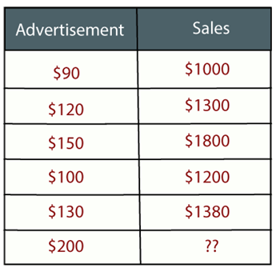
REGRESSION

Slide 30
REGRESSION
Now, the company wants to do the advertisement of $200 in the year 2019 and wants to know the prediction about the sales for this year. So to solve such type of prediction problems in machine learning, we need regression analysis.
Regression is a supervised learning technique
which helps in finding the correlation between variables and enables us to predict the continuous output variable based on the one or more predictor variables. It is mainly used for prediction, forecasting, time series modeling, and determining the causal-effect relationship between variables.
In Regression, we plot a graph between the variables which best fits the given data points, using this plot, the machine learning model can make predictions about the data. In simple words, "Regression shows a line or curve that passes through all the data points on target-predictor graph in such a way that the vertical distance between the data points and the regression line is minimum." The distance between data points and line tells whether a model has captured a strong relationship or not.

Slide 31
TERMINOLOGY RELATED TO SUPERVISED LEARNING
Dependent Variable: The main factor in Regression analysis which we want to predict or understand is called the dependent variable. It is also called target variable.
Independent Variable: The factors which affect the dependent variables or which are used to predict the values of the dependent variables are called independent variable, also called as a predictor.
Outliers: Outlier is an observation which contains either very low value or very high value in comparison to other observed values. An outlier may hamper the result, so it should be avoided.
Multicollinearity: If the independent variables are highly correlated with each other than other variables, then such condition is called Multicollinearity. It should not be present in the dataset, because it creates problem while ranking the most affecting variable.
Underfitting and Overfitting: If our algorithm works well with the training dataset but not well with test dataset, then such problem is called Overfitting. And if our algorithm does not perform well even with training dataset, then such problem is underfitting.

Slide 32
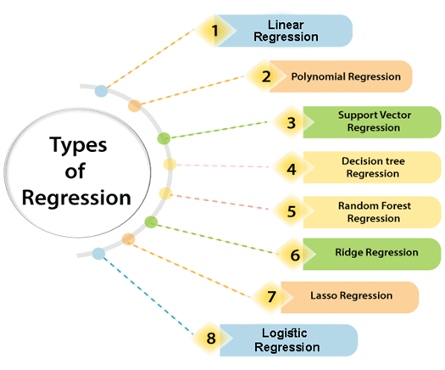
TYPE OF THE REGRESSION ANALYSIS

Slide 33
LINEAR REGRESSION
Linear regression is a statistical regression method which is used for predictive analysis.
It is one of the very simple and easy algorithms which works on regression and shows the relationship between the continuous variables.
It is used for solving the regression problem in machine learning.
Linear regression shows the linear relationship between the independent variable (X-axis) and the dependent variable (Y-axis), hence called linear regression.
If there is only one input variable (x), then such linear regression is called simple linear regression. And if there is more than one input variable, then such linear regression is called multiple linear regression.
The relationship between variables in the linear regression model can be explained using the below image. Here we are predicting the salary of an employee on the basis of the year of experience.

Slide 34
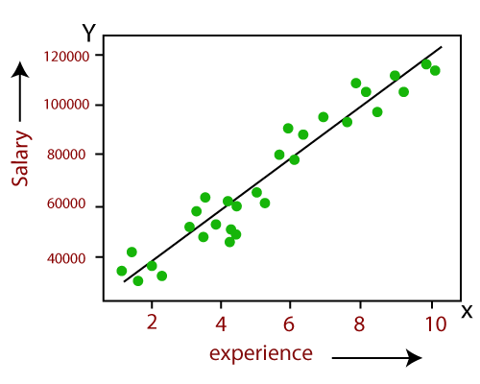
LINEAR REGRESSION
Y= aX+b
y=dependent
(target)
x=independent
(predictors)
a,b are
parameters.

Slide 35
POLYNOMIAL REGRESSION
Polynomial Regression is a type of regression which models the non-linear dataset using a linear model.
It is similar to multiple linear regression, but it fits a non-linear curve between the value of x and corresponding conditional values of y.
Suppose there is a dataset which consists of datapoints which are present in a non-linear fashion, so for such case, linear regression will not best fit to those datapoints. To cover such data points, we need Polynomial regression.
In Polynomial regression, the original features are transformed into polynomial features of given degree and then modeled using a linear model. Which means the data points are best fitted using a polynomial line.

Slide 36
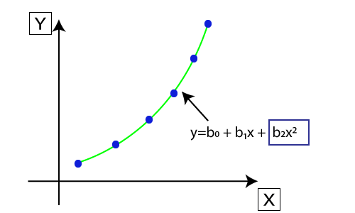
POLYNOMIAL REGRESSION

Slide 37
POLYNOMIAL REGRESSION
The equation for polynomial regression also derived from linear regression equation that means Linear regression equation Y= b₀+ b₁x, is transformed into Polynomial regression equation Y= b₀+b₁x+ b₂x²+ b₃x³+.....+ b_{n}x^{n}.
Here Y is the predicted/target output, b₀, b₁,... b_{n} are the regression coefficients. x is our independent/input variable.
The model is still linear as the coefficients are still linear with quadratic

Slide 38
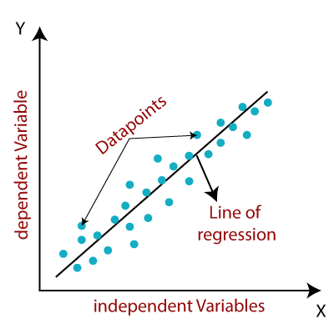
FINDING THE BEST FIT LINE

Slide 39
FINDING THE BEST FIT LINE
When working with linear regression, our main goal is to find the best fit line that means the error between predicted values and actual values should be minimized. The best fit line will have the least error.
Cost function-
The different values for weights or coefficient of lines (a₀, a₁) gives the different line of regression, and the cost function is used to estimate the values of the coefficient for the best fit line.
Cost function optimizes the regression coefficients or weights. It measures how a linear regression model is performing.
We can use the cost function to find the accuracy of the mapping function, which maps the input variable to the output variable. This mapping function is also known as Hypothesis function.
For Linear Regression, we use the Mean Squared Error (MSE) cost function, which is the average of squared error occurred between the predicted values and actual values. It can be written as:

Slide 40

FINDING THE BEST FIT LINE
For the above linear equation, MSE can be calculated as:
Where,
N=Total number of observation
Yi = Actual value
(a1x_{i}+a₀)= Predicted value.
Residuals: The distance between the actual value and predicted values is called residual. If the observed points are far from the regression line, then the residual will be high, and so cost function will high. If the scatter points are close to the regression line, then the residual will be small and hence the cost function

Slide 41
FINDING THE BEST FIT LINE
Gradient Descent:
Gradient descent is used to minimize the MSE by calculating the gradient of the cost function.
A regression model uses gradient descent to update the coefficients of the line by reducing the cost function.
It is done by a random selection of values of coefficient and then iteratively update the values to reach the minimum cost function.
Model Performance:
The Goodness of fit determines how the line of regression fits the set of observations. The process of finding the best model out of various models is called optimization. It can be achieved by below method:

Slide 42

FINDING THE BEST FIT LINE
R-squared
is a statistical method that determines the goodness of fit.
It measures the strength of the relationship between the dependent and independent variables on a scale of 0-100%.
The high value of R-square determines the less difference between the predicted values and actual values and hence represents a good model.
It is also called a coefficient of determination, or coefficient of multiple determination for multiple regression.
It can be calculated from the below formula:

Slide 43
ASSUMPTIONS OF LINEAR REGRESSION
Below are some important assumptions of Linear Regression. These are some formal checks while building a Linear Regression model, which ensures to get the best possible result from the given dataset.
Linear relationship between the features and target: Linear regression assumes the linear relationship between the dependent and independent variables.
Small or no multicollinearity between the features: Multicollinearity means high-correlation between the independent variables. Due to multicollinearity, it may difficult to find the true relationship between the predictors and target variables. Or we can say, it is difficult to determine which predictor variable is affecting the target variable and which is not. So, the model assumes either little or no multicollinearity between the features or independent variables.
Homoscedasticity Assumption: Homoscedasticity is a situation when the error term is the same for all the values of independent variables. With homoscedasticity, there should be no clear pattern distribution of data in the scatter plot.

Slide 44
ASSUMPTIONS OF LINEAR REGRESSION
Below are some important assumptions of Linear Regression. These are some formal checks while building a Linear Regression model, which ensures to get the best possible result from the given dataset.
Normal distribution of error terms: Linear regression assumes that the error term should follow the normal distribution pattern. If error terms are not normally distributed, then confidence intervals will become either too wide or too narrow, which may cause difficulties in finding coefficients. It can be checked using the q-q plot. If the plot shows a straight line without any deviation, which means the error is normally distributed.
No autocorrelations: The linear regression model assumes no autocorrelation in error terms. If there will be any correlation in the error term, then it will drastically reduce the accuracy of the model. Autocorrelation usually occurs if there is a dependency between residual errors.

Slide 45
MOSTLY TYPE OF DATASET TO WORK ON IN AI
Below are the mostly types of the dataset to work on when doing Artificial intelligence.
Numbers
Categoricals
Texts
Audio
Videos
Images

Slide 46
GENERAL STEPS TO SOLVE MOSTLY MACHINE LEARNING PROBLEMS
Below are the mostly STEPS to solve a machine learning problems:
Gathering data . Example Scraping using selenium , beautifully soap , scrapy
Performing EDA . Example Exploratory and Analysis of the Data
Preprocessing of the Data . Example feature engineering , data imputation , data cleaning and data transformation .
Cross validation . Example Hold-out ,k-fold,stratified k-fold,repeated stratified k-fold.
Feature scaling (optional) due to depend on some algorithms and normalization of the data.
Data modelling
Model training
Predictions.
Model optimizations and regulation . Example Ensembling techniques such as stacking ,bagging , boosting , hyperparameters tuning also using searching algorithms like grid and random search .

Slide 47
BOOKS AND USEFULL LINKS
AI LEARNING MATERIALS
Krish Naiki Youtube
Total Data science
https://www.youtube.com/user/pantechsolutions

Slide 48
IMPLEMENTATION OF LINEAR REGRESSION
THANKS !!!! …IT IS TIME FOR HANDS ON A LINEAR REGRESSION SUPERVISED MACHINE LEARNING

